Slide 1
Beer Reviews
An analysis

Slide 2
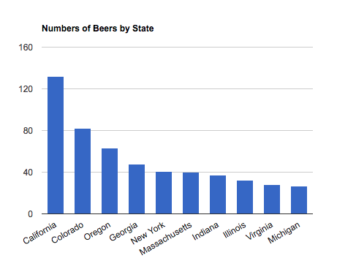
Where are most of the beers from?

Slide 3
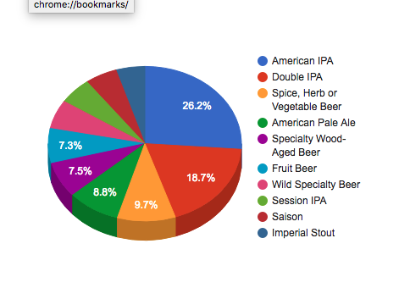
Which brew styles have the most preponderance?

Slide 4
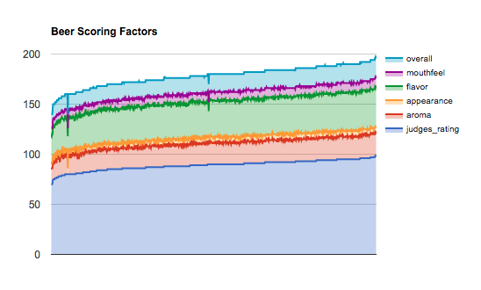
How do all the measures ‘measure up?’

Slide 5
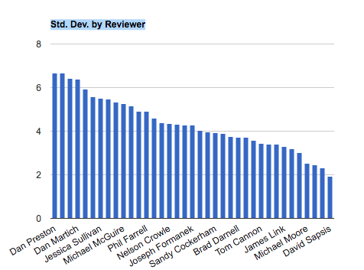
Are the reviewers being critical enough?

Slide 6
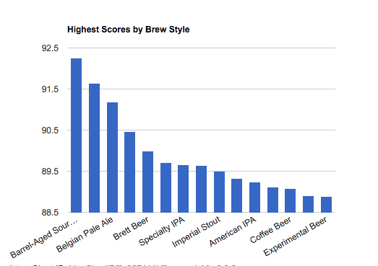
Which brew style gets the highest scores?

